Slide 1
A Comparative Study of Programming Languages in Rosetta Code

Slide 2
Time allocation
Overview
Research Setup
Programming paradigms overview
Results
Validity & Discussion

Slide 3
Overview

Slide 4
Overview
What is the best programming language?
What is the best programming language for feature/project X ?
What are the advantages of a language over another?

Slide 5
Overview
What might affect my selection of language ?
My languages knowledge
Project/company decisions
Moods and trends
Existence of libraries/tools
Open source community/support
Empirical evidence

Slide 6
Empirical Evidence
Conciseness
Maintainability
Performance
Safety
Fit the running environment

Slide 7
Research

Slide 8
Research Questions
RQ1 : Which programming languages make for more concise code ?
RQ2 : Which programming languages compile into smaller executables ?
RQ3 : Which programming languages have better running-time performance ?

Slide 9
Research Questions
RQ4 : Which programming languages use memory more efficiently ?
RQ5 : Which programming languages are less failure-prone?

Slide 10
Research Method – Past research
Controlled experiments.
Groups of programmers (students)
Small programming tasks
Limited time
Pros:
Cons:

Slide 11
Research Method – Past research
Public repositories (Github)
Experienced programmers
Large projects
Large time-span
Pros:
Cons:

Slide 12
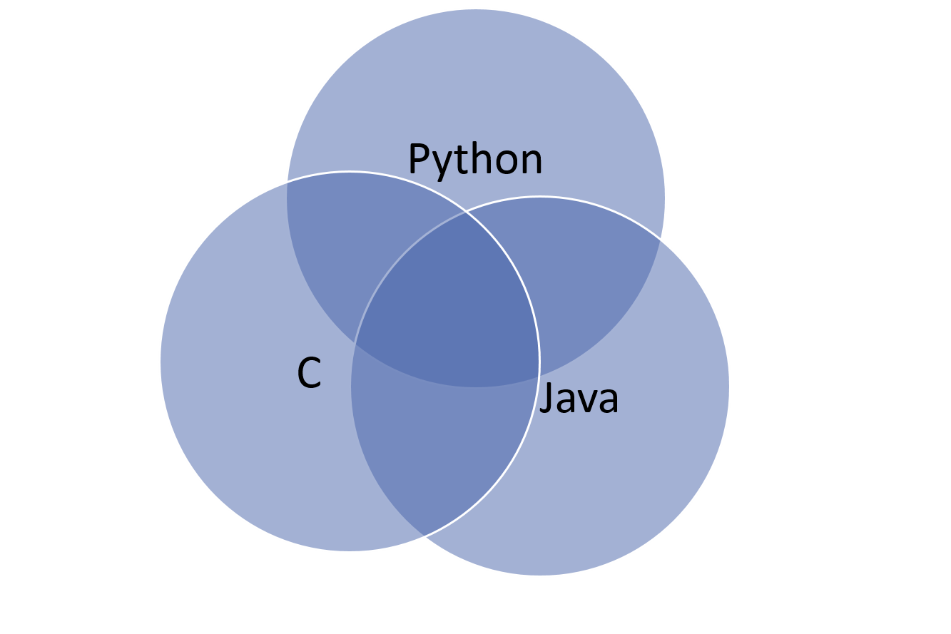
Research Method
Rosetta Code – a code repository
Online, open-source
Purposes
Tasks, Languages, Solutions
745 tasks, 379 languages

Slide 13
Research Method
Task examples
Algorithmic: Bubble sort, Mat-mult
I/O: GUI application, HTTP request, File I/O
Text: Parsing (XML), Strings
Data structures: List traversal, Trees etc.

Slide 14
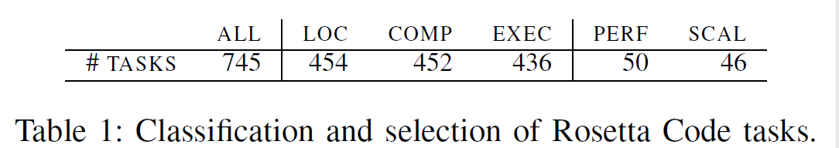
Research Method – Task selection
745 tasks.
Select clearly-defined tasks.
Minor variants of a unique problem.

Slide 15
Research Method – Language selection
Select from 379 languages (!):
Prefer popular languages (TIOBE rating).
Ensure enough data for statistical analysis (common in Rosetta).
Mitigate “Hyped” languages.

Slide 16
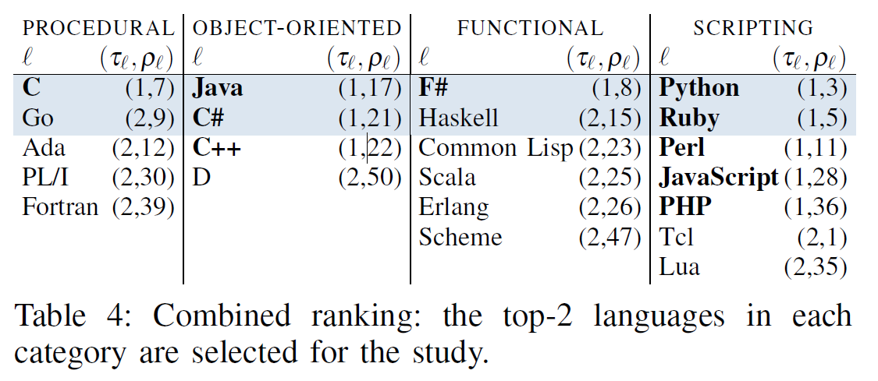
Research Method
8 languages that were compared.
Divided into 4 groups based on their Programming Paradigm/“type”.

Slide 17
Time allocation
Overview
Research Setup
Programming paradigms overview
Results
Validity & Discussion

Slide 18
Programming Paradigms

Slide 19
Definition
Programming Paradigm = Fundamental style of a language.¹
i.e. Java follows object-oriented paradigm.
Some languages are multi-paradigm.

Slide 20
Languages by paradigms
Languages in study:
Procedural : C, Go
Object Oriented: Java, C#
Functional: Haskell, F#
Scripting (*): Python, Ruby

Slide 21
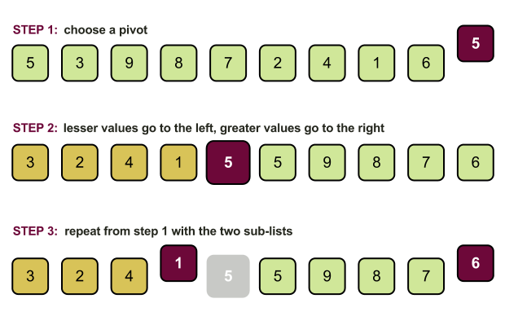
Programming Paradigms
Let’s demonstrate the PP’s by a known algorithm:
Quicksort:

Slide 22

Procedural Paradigm
Procedural programming is based upon the concept of procedure calls.
Each procedure = a set of computational steps to carry out.
Sequential.
Examples: C, Go, C++

Slide 23
Procedural Paradigm
Programming with side effects.
Top-down approach:
one “main” procedure
has 5-6 sub routines, each built once again on 5-6 subroutines.
And so on
Other approaches (recursive).

Slide 24
Procedural Paradigm
int main () { int a[] = {4, 65, 2, -31, 0, 99, 2, 83, 782, 1}; int n = sizeof a / sizeof a[0]; int i; for (i = 0; i < n; i++) printf("%d%s", a[i], i == n - 1 ? "\n" : " "); quick_sort(a, n); for (i = 0; i < n; i++) printf("%d%s", a[i], i == n - 1 ? "\n" : " "); return 0; }

Slide 25
Procedural Paradigm
void quick_sort (int *a, int n) { int i, j, p, t; if (n < 2) return; p = a[n / 2]; for (i = 0, j = n - 1;; i++, j--) { while (a[i] < p) i++; while (p < a[j]) j--; if (i >= j) break; t = a[i]; a[i] = a[j]; a[j] = t; } quick_sort(a, i); quick_sort(a + i, n - i); }

Slide 26

Object oriented paradigm
Based on concept of “Objects”.
Data = “fields”
Code = “methods”
Objects are instances of class (prototype).
Objects access their own data/code.
Interaction with other objects.

Slide 27
Object oriented paradigm
Encapsulation
“Resource Acquisition Is Initialization (RAII)”
Inheritance
Polymorphism
Example languages: Java, C#, C++, Python

Slide 28
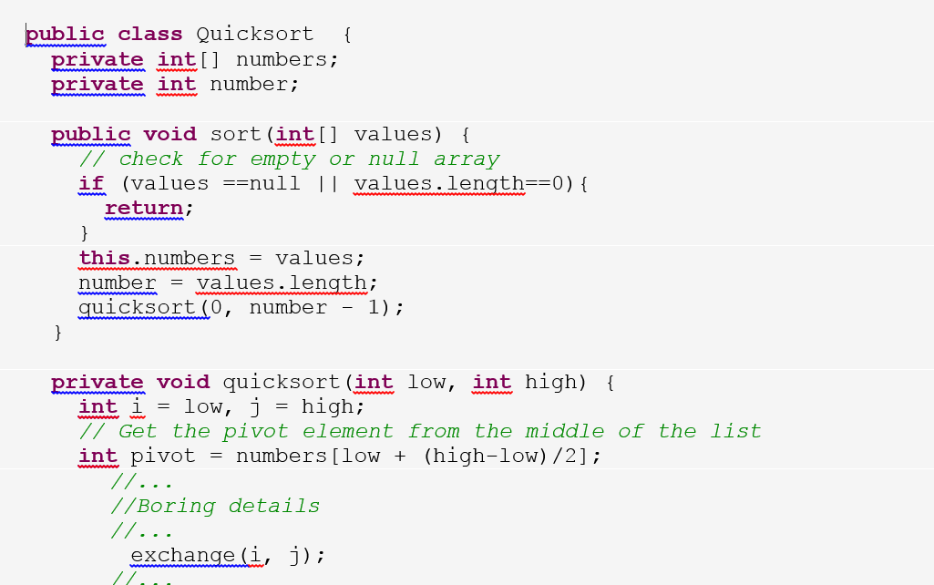
Object oriented paradigm

Slide 29
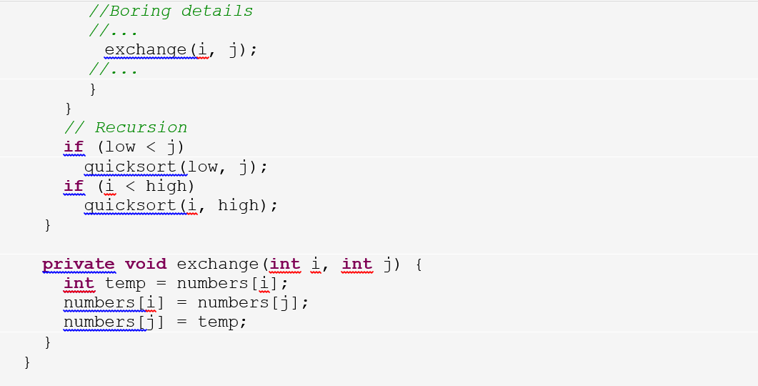
Object oriented paradigm

Slide 30
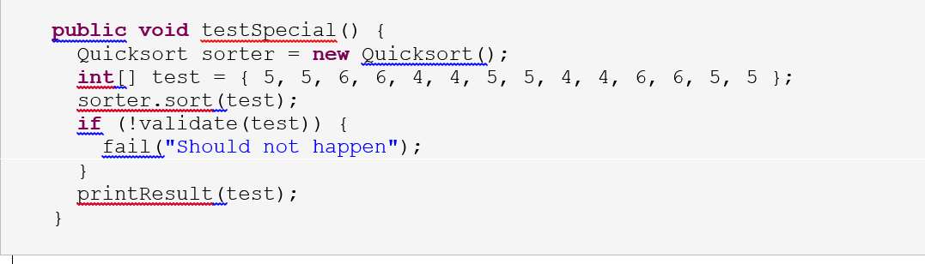
Object oriented paradigm

Slide 31
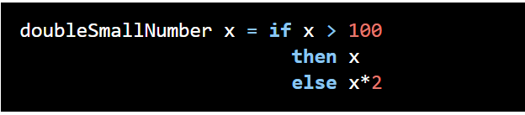
Functional Paradigm
Derived from the word function.
Everything is a function, everything is evaluated.
No side effects !
Example languages: LISP/Scheme, Haskell, ML, Python ...

Slide 32
Haskell
A purely-functional programming language.
Strong static typing
Compiled to native code
Some features: Lazy evaluation

Slide 33
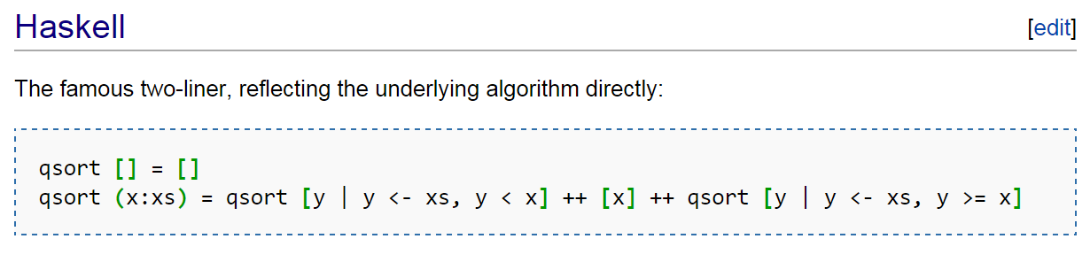
Functional Paradigm

Slide 34
Time allocation
Overview
Research Setup
Programming paradigms overview
Results
Validity & Discussion

Slide 35
Results

Slide 36
Conciseness
RQ1 : Which programming language make for more concise code ?

Slide 37
Conciseness
RQ1 : Which programming language make for more concise code ?
Non-comment, non-blank lines of code
Not required to run correctly, or even compile
Shortest solution for each task in a language

Slide 38
Why it is important?
Bug density is constant across programming languages.
(Meaning – shorter means less bugs.)¹
Readability
Ability for code to be maintained, fixed, enhanced, tested etc.
By peers or by original writer

Slide 39
Example – File I/O
Read file into buffer (in chunks), output to another file.

Slide 40
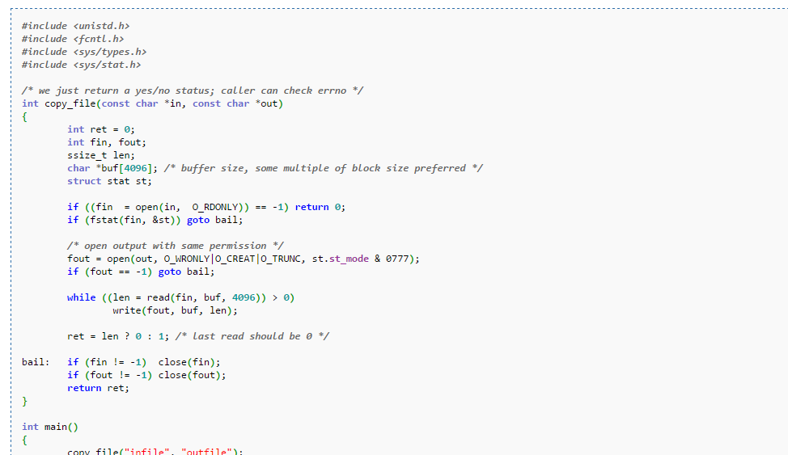
C

Slide 41
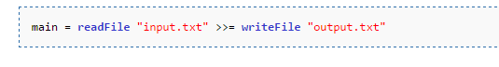
Haskell

Slide 42
What might improve conciseness?
Simplified, expressive syntax
Objects, abstractions
Less checks on variable’s state
Use of external libraries
String interfaces
Collection interfaces

Slide 43

Any guess ?
Conciseness
Procedural | OO | Functional | Scripting
C | Java | Haskell | Python
Go | C# | F# | Ruby

Slide 44
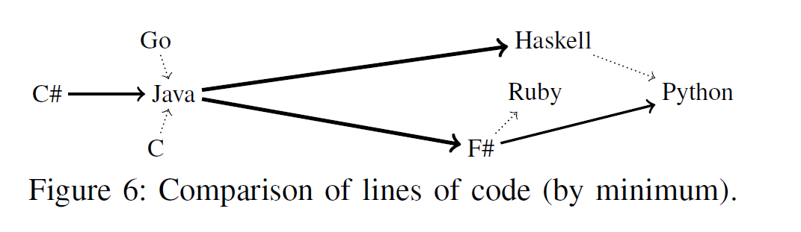
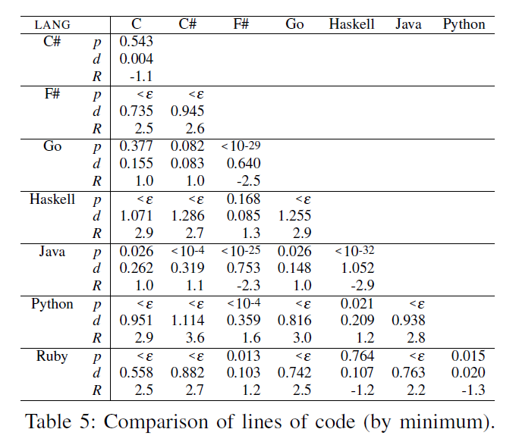
Results – RQ1 (Conciseness / Lines of code)

Slide 45
Conciseness (Lines of code)
Languages divided into two groups:
Group 1: functional and scripting – more concise
Group 2: OO and procedural – longer code
Major differences. i.e. Java 2.2-2.9 longer than Group 1.
Within the groups – no major difference.
Winner (by small amount): Python
Question: Is shorter program easier to understand ?

Slide 46
Results – RQ1 (Conciseness / Lines of code)

Slide 47
Size Of Executable
RQ2 : Which programming language compile into smaller executables ?
Only those compiled successfully.
Languages are divided by whether they:
Compile into byte-code
Compile into native code
Ruby language – excluded, has no executable (interpreted).

Slide 48
Why is it important?
Executable is saved on HD, transported on network.
Executable (at least parts of it) is loaded into memory. (more at RQ4)
May turn irrelevant as years go by: HD sizes and speed increase (SSD).
Embedded systems.

Slide 49
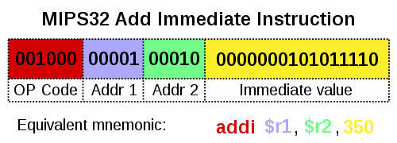
Native code
Code compiled for particular processor.
Programs compiled into native code:
C, C++, Go, Haskell

Slide 50
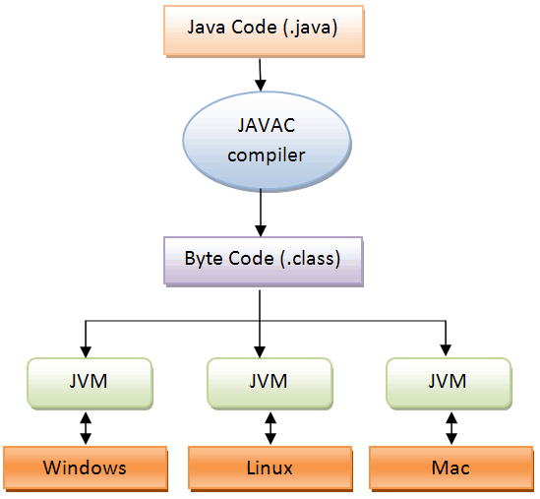
Byte-code
Definition
In real time:
Interpreted (JVM).
Compiled (JIT).
Highly portable.
Example languages: Java, Python, C#, F#

Slide 51
Static vs. Dynamic linkage
If static libraries are called, the linker will copy all the modules referenced by the program directly into the executable.
Dynamic Linking Allows a process to add, remove, replace or relocate object modules during its execution.

Slide 52
Static vs. Dynamic linkage
…

Slide 53
Any guess ?
Size of executable
 | Language | Byte Code | Dynamic Linking
Procedural | C |  | dynamic
 | Go |  | static
OO | Java | V | -
 | C# | V | -
Functional | Haskell |  | static
 | F# | V | -
Scripting | Python | V | -

Slide 54
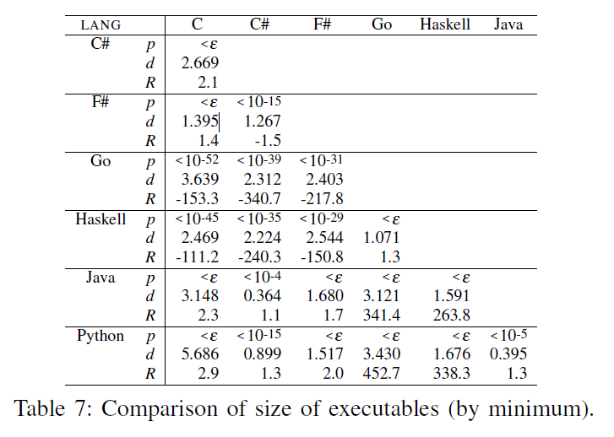
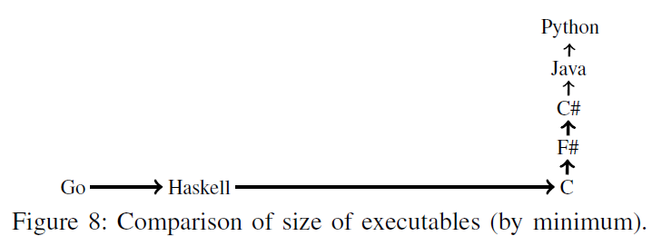
Results – RQ2 (Size of executable)

Slide 55
Size of Executable
Three consecutive groups:
Group 1: Native, Large executables (Go, Haskell)
Group 2: Native, Small executable (C)
Group 3: Bytecode, Small executable (F#, C#, Java, Python)
Winner (by small amount): Python
Losers: Go, Haskell
Ratio: Big, i.e. Java program 263 times smaller than Haskell !

Slide 56
Size of Executable
Languages that compile to byte code – are significantly smaller.
Languages that prefer Static linking produce much larger executables.

Slide 57
Running Time
RQ3 : Which programming languages have better running-time performance ?
Measure running time.
Small set of “Scalability tasks” – tasks that their input can be scaled up to create computing-intensive workload.
Exclude programs with errors and timeouts (over 3 mins.)

Slide 58
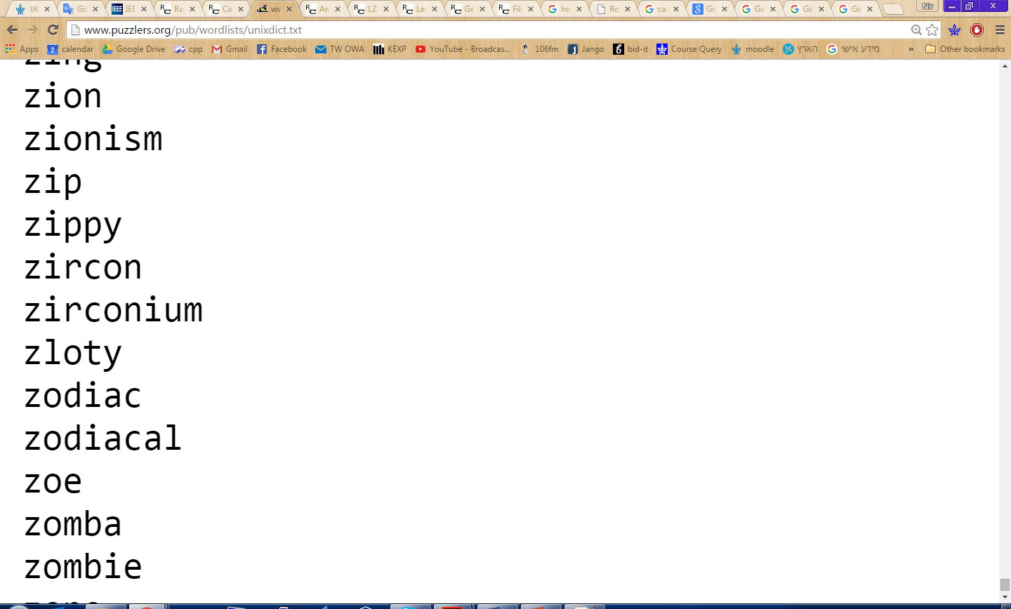
Running Time
Example: Anagrams
Anagram = two words that have the same letters in different order. i.e. veil, levi
Task: on the dictionary in unixdict.txt, find the longest sets of anagrams (sets that contain the most words).

Slide 59
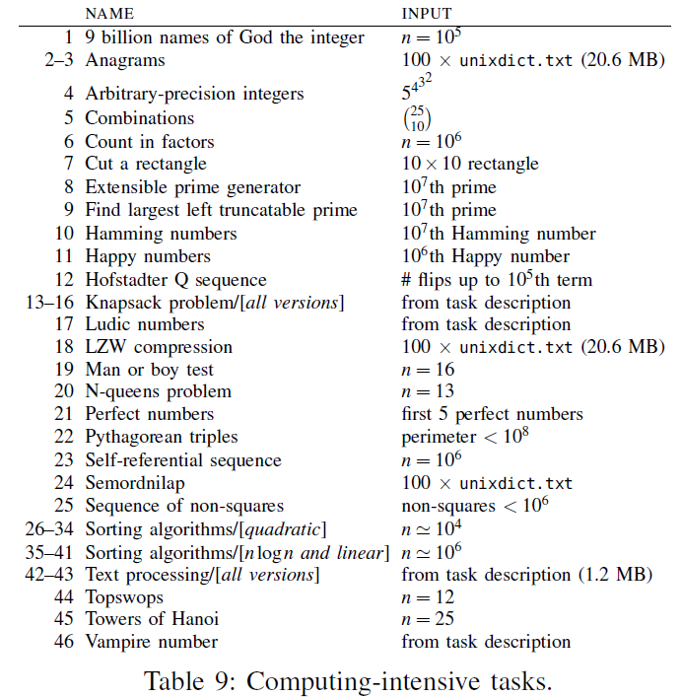
“Scalability tasks”

Slide 60
Running Time
“Scalability tasks”:
Text-processing tasks (Anagrams, Semordnilap).
Combinatorial puzzles (N-Queens problem, Towers of Hanoi).
NP-Complete problems (Knapsack).
Sorting algorithms.
All programs ran on very same inputs.
Minimize effect of I/O.

Slide 61
Running Time - Why it is important?
Well, duh…
However:
In real-time systems it is critical.
Systems with performance needs – large inputs (i.e. web traffic).
On “information”/”everyday“ type applications – maybe less important?
“Most applications do not actually need better performance than Python offers”¹

Slide 62
What might affect running time?
Object oriented world
Constructors, Destructors.
Virtual tables.
Heap management, Garbage collection.
Transitions into machine code.

Slide 63
Any guess ?
Running time – computing intensive tasks
 | Language | Interpreted/byte code | OO features | Functional features
Procedural | C
 | Go
OO | Java | V | V
 | C# | V | V
Functional | Haskell |  |  | V
 | F# | V |  | V
Scripting | Python | V

Slide 64
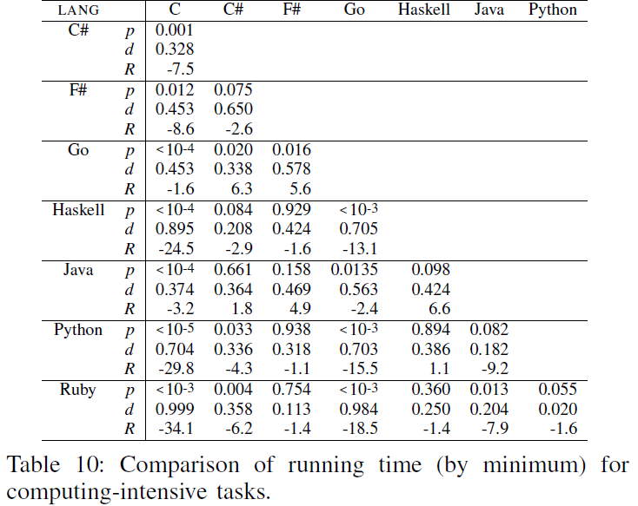
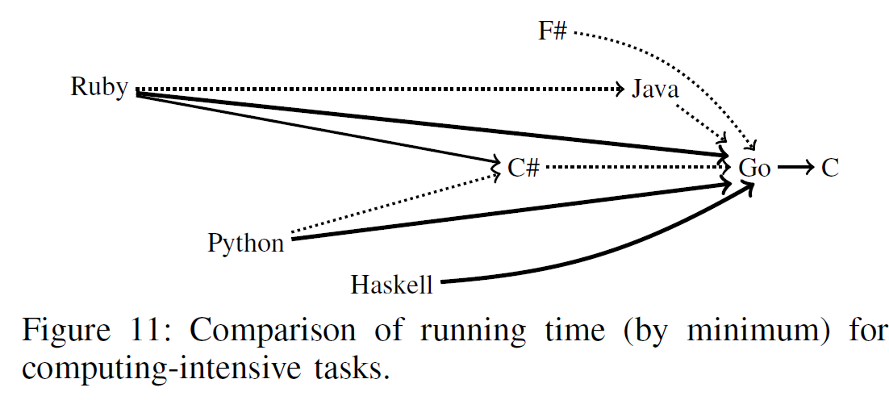
Results – RQ3 (Running Time: Computing-intensive tasks)

Slide 65
Running Time
Procedural languages win. Scripting/Functional languages lose.
Big winner: C, Runner-up: Go (1.6 slower than C).
Ratio: Big – Haskell and Python 15.5-13.1 slower than Go.

Slide 66
Running Time – Performance tasks
Tasks that can be measured for performance, but don’t scale naturally to large instances.
Checksum algorithms (Credit Card Validation).
String manipulations (reversing words inside a string).
System-library access (Securing a temp file).

Slide 67
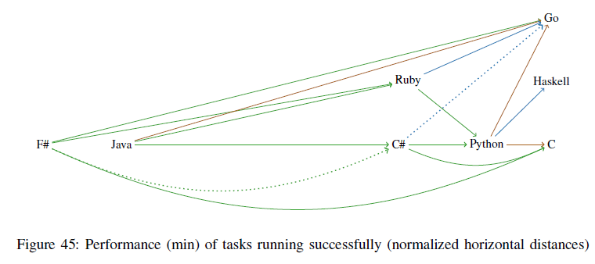
Results – RQ3 (Running Time: “Normal” performance tasks)

Slide 68
Running Time – Performance tasks
Results are much more varied.
The ratios are smaller: C# on Java: 2.5 faster, Python on Java: 6.6 faster.
Winners: procedural and Haskell, but all others are equally competitive.
Results show a difference between “everyday” and “computing intensive”.

Slide 69
Memory Usage
RQ4 : Which programming languages use memory more efficiently ?
Measured maximum RAM size consumed by the program.
Measured on the “Scalability tasks”.
Those who ran without errors or timeouts.
Includes memory of “runtime environment” (i.e. JVM)

Slide 70
Mem. Usage - Why it is important?
As in “Size of executable” discussion, does the value of RAM decease ?
Still:
Application competing with others (mobile).
On performance driven systems – Exceeding max RAM affects performance badly (swap to disk).

Slide 71
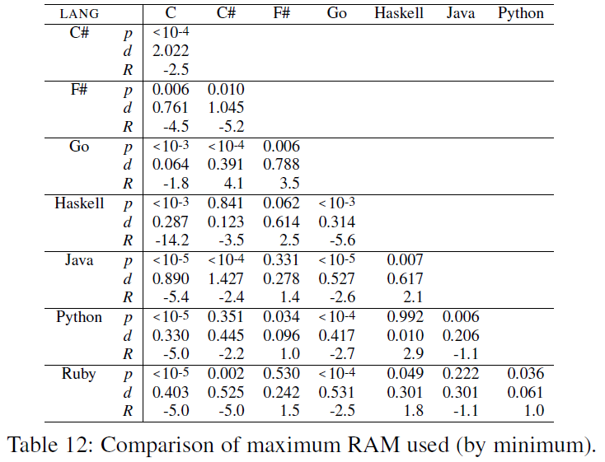
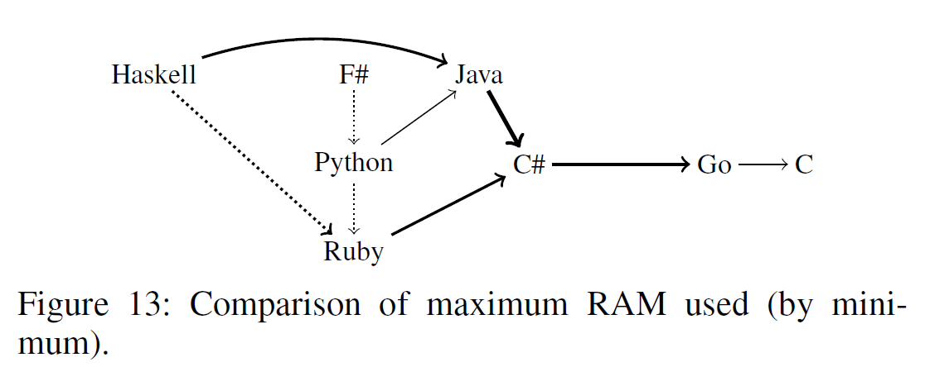
Results – RQ4 (Max Memory usage)

Slide 72
Safety / failure-proneness
RQ5 : Which programming languages are less failure-prone?
Failure = exit code other than 0.
Timeout not considered.

Slide 73
Safety / failure-proneness
Why is it important ?
What might affect?
Weakly/Strongly typed
Compiled or interpreted

Slide 74
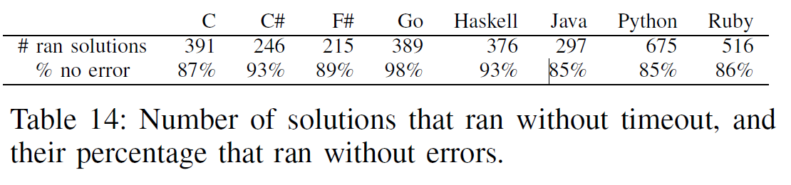
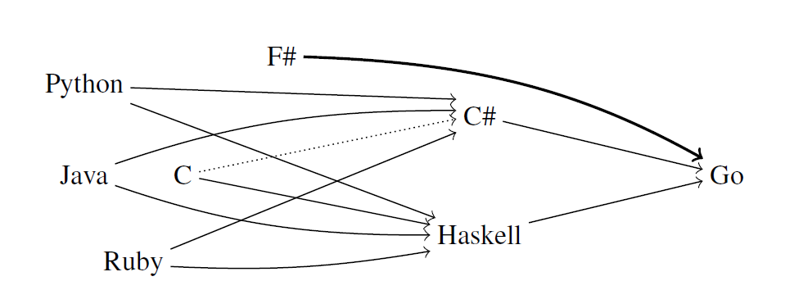
Results – RQ5 (Safety)

Slide 75
Time allocation
Overview
Research Setup
Programming paradigms overview
Results
Validity & Discussion

Slide 76
Threats to validity
Internal validity
External validity
Bias for Algorithmic and small problems
Contributors
Selection of languages

Slide 77
Further discussion
The people that makes the code. ¹
Other aspects: Design, algorithms, work procedures.
Industry

Slide 78
Bibliography

